Slide 1

CampID Project
Abdullah Omair, Vidhi Chitalia, Aishwarya Mathkar, Krutarth Patel, Manni Si, Eric Glassman

Slide 2

Outline
Purpose & Goals
Data Preparation
Data cleaning & wrangling
Data Visualization
Basic Statistics
Databasing Project
Dropdown Filter Model
Recommendation System
Conclusion

Slide 3
Data Cleaning
The purpose of data cleaning is to ensure that the data is consistent and usable.
Cleaning involved removal of null values and duplicates, normalised data columns by forming significant groups within desired columns such as Skills, Required Skills, Age, Schedule and Price.
These groups will be later helpful in building the recommendation systems.

Slide 4
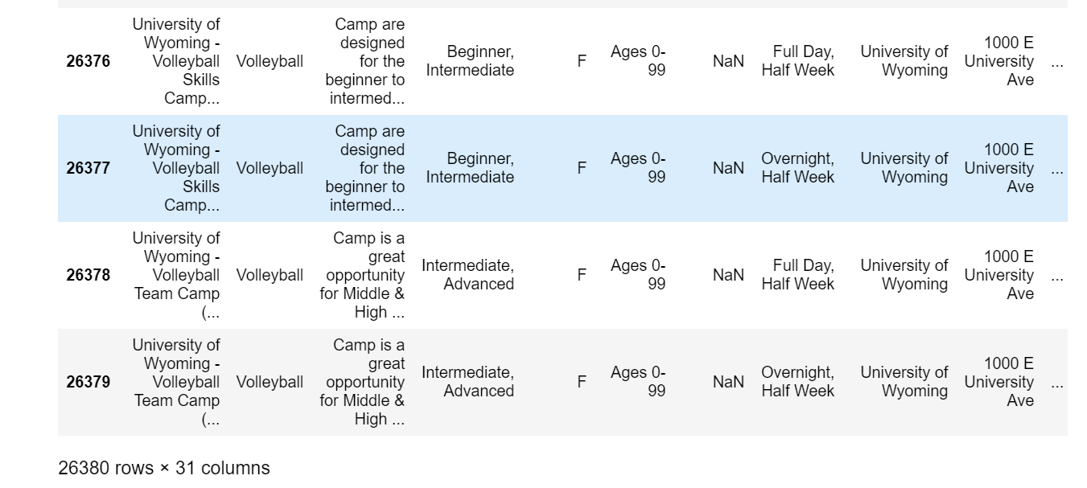
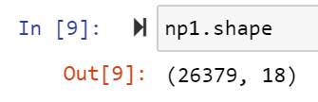
Initially the dataset contains 26380 rows and 31 columns
After dropping the null values in both columns and rows we have

Slide 5
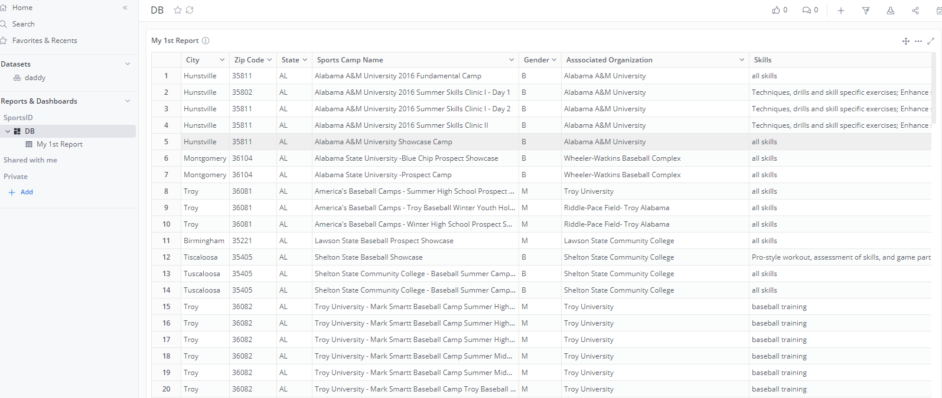
Transfer Data and Databasing

Slide 6
Dropdown Filter Model

Slide 7
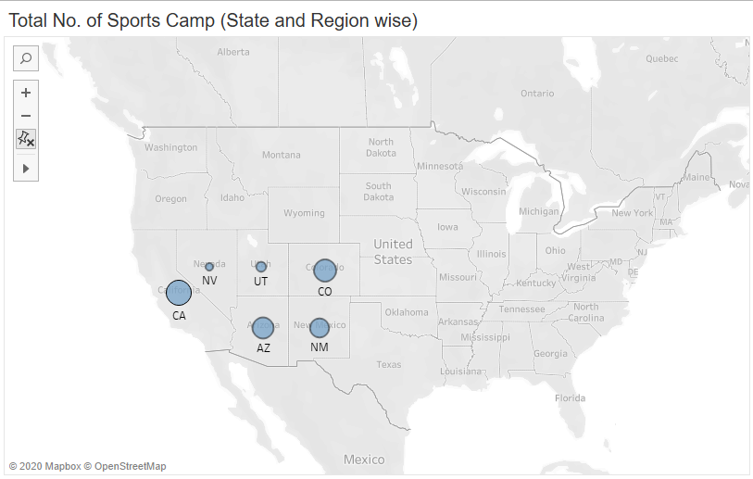
Data Visualizations - I

Slide 8
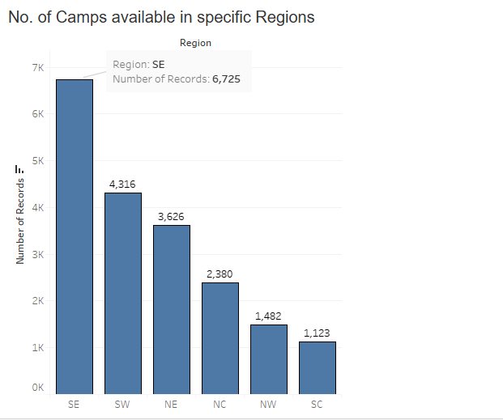
Data Visualizations - II

Slide 9
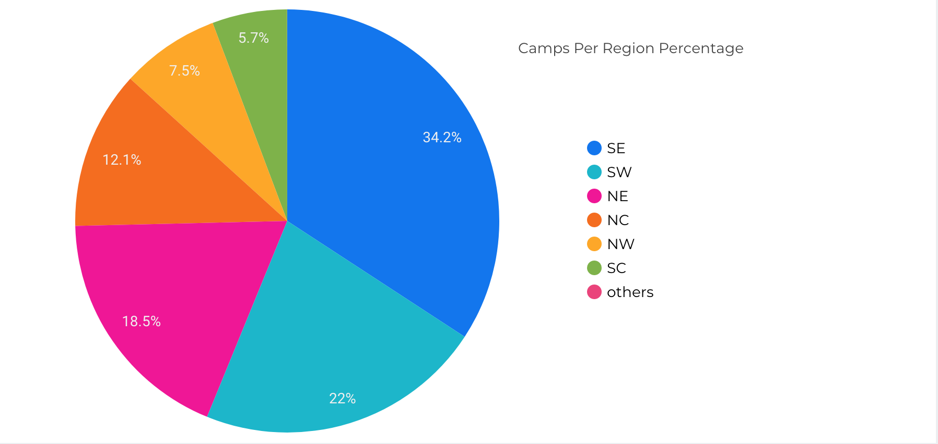
Data Visualizations - II

Slide 10
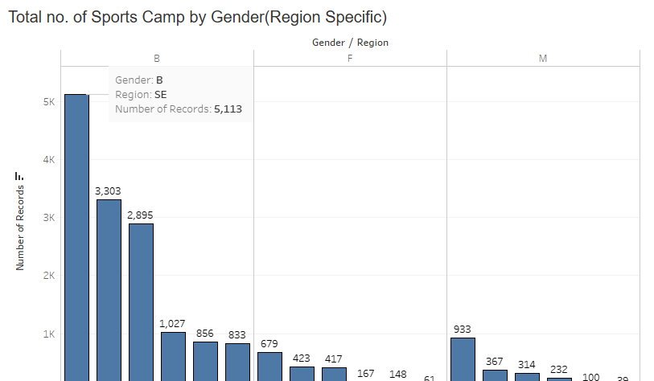
Data Visualizations - III
Notes:
14000 Both, 1895 Female, 1985 Male

Slide 11
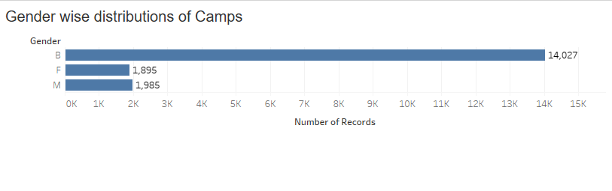

Data Visualization - IV

Slide 12
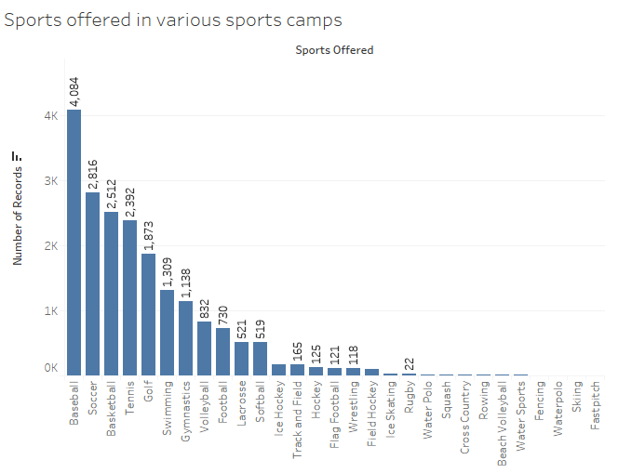
Data Visualization - V
Notes:
Baseball accounts for over 55% of all camps

Slide 13
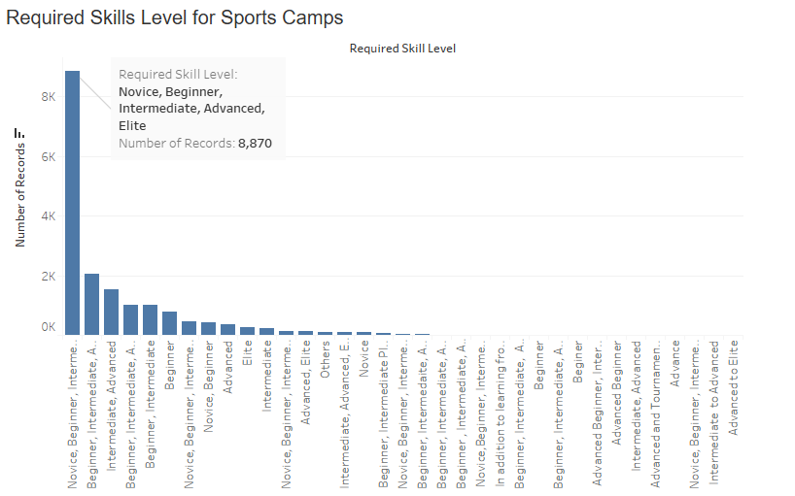
Data Visualization - VI

Slide 14
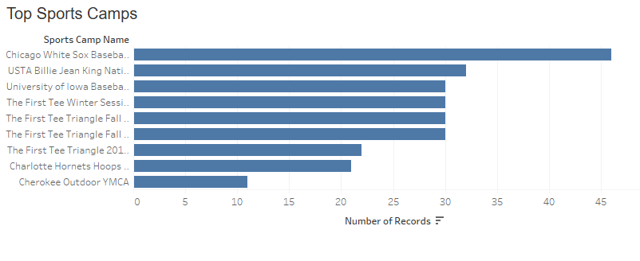
Data Visualization - VII

Slide 15
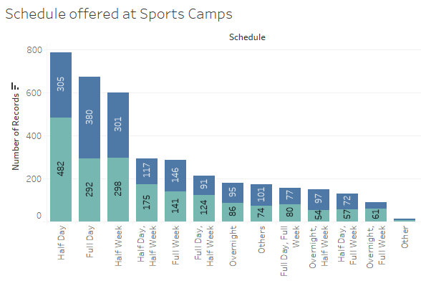
Data Visualization - VIII

Slide 16
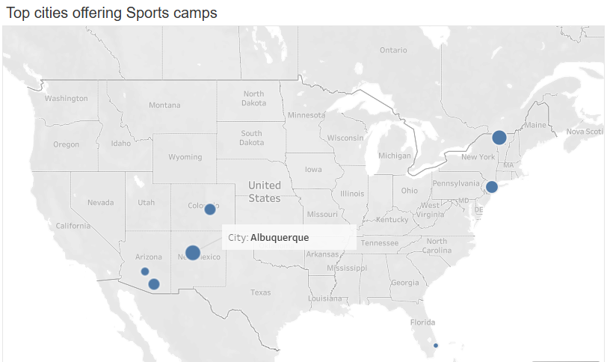
Data Visualization - IX

Slide 17
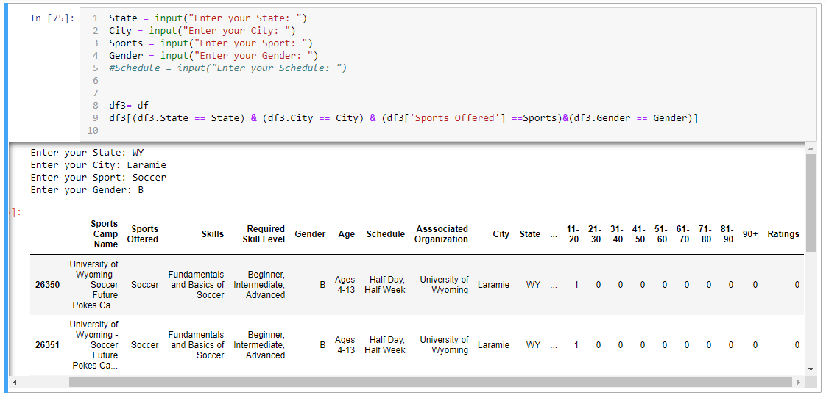
Recommendation System: Collaborative Filtering

